Slide 1
Optimizing Pulse Shape Discrimination in a PEN Scintillator
Eli Ward

Slide 2
Scintillation Overview
Radiation ejects electrons or protons from molecules in scintillator
Ejected charged particles ionize nearby atoms
When ionized atoms recaptured electrons, they are in excited state
Excited states in molecules decay to lower energy states and produce scintillation (characteristic pulses of photons)
Radiation includes gamma rays, neutrons, muons, alpha particles
Gamma rays eject electrons, neutrons produce nuclear recoils
Muons and alpha particles ionize atoms directly
Notes:
Nuclear recoil out of atom
Electrons and muons are low ionizing particles, travel very far but produce different levels of ionization than ions
Protons are highly ionizing particles, travel much shorter distances with same initial energy
Recaptured electrons in excited states can immediately decay to ground states if they have opposite spin as the ground state
If recaptured electrons in excited states have same spin as the ground state, they form a triplet state and that is a first forbidden decay

Slide 3
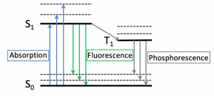
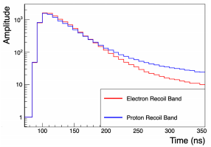
Delayed Fluorescence vs Phosphorescence
Recoiling electrons fluoresce mainly via decaying singlet states
Singlet states decay quickly
Recoiling protons fluoresce via decaying singlet states and triplet-triplet annihilation
Triplet-triplet annihilation results in delayed fluorescence
Can see that scintillation pulse from proton has longer tail
Notes:
Electrons move quickly, don’t spend very much time near atoms, so don’t create many (more complex) triplet states
Protons with same energy move much more slowly, spend more time near atoms, create greater density of triplet states
Single triplet states will phosphoresce
Arrow is intersystem crossing (no intersystem crossings in PEN)
Dashed lines are vibronic energy levels, solid lines are electron energy levels
Protons at the end of their recoil capture electron and become hydrogen
Electrons at the end of their recoil get captured by atom

Slide 4
What makes a good scintillator?
Efficient conversion of ionization to light
10,000 photons/MeV
Transparent to light created within scintillator
Attenuation length of ~1 m
Produces easily detectable wavelengths of light
UV to visible light
PEN scintillators:
Produce ~3500 photons/MeV
Have attenuation length on the order of centimeters
Have peak scintillation at ~450 nm
Notes:
Don’t want light to be absorbed by scintillator and converted to heat
Good scintillators produce ~10,000 photons/MeV (energy of electronic recoil, nuclear can have quenching)
PEN produces 3500 photons/MeV
Quenching = Amount of light lost
Good scintillators have an attenuation length of ~1 m
PEN scintillator has attenuation length on the order of centimeters
Attenuation length describes distance traveled through scintillator it takes for probability of photon being absorbed to reach 1/e = 63%

Slide 5
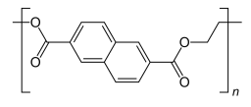
Advantages of PEN Scintillators
Polyethylene naphthalate (PEN) is a pretty good but not great scintillator material, so why are we interested in it?
High yield strength at cryogenic temperatures
Useful in experiments with germanium detectors (77 K)
Chemically resistant, can be aggressively cleaned with acids
Minimizes radiation contamination for use in low background measurements
Notes:
Polymer; chain of carbon, hydrogen and some oxygen atoms
450 nm, easy wavelength range to detect with PMTs
low background (few number of events)

Slide 6
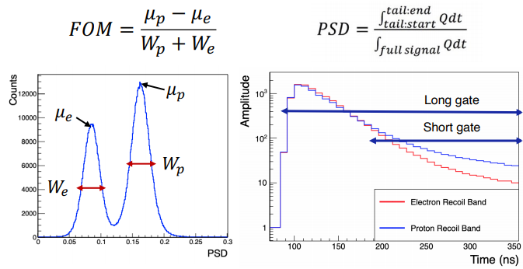
Pulse Shape Discrimination
PSD: Ratio of area under pulse tail to area of entire pulse
FOM (Figure of Merit): Describes how easily electron and proton scintillation pulses are distinguished
Notes:
Long gate vs short gate?
Proton has longer pulse tail, electron has shorter pulse tail (b/c singlet states)
Pick point where you can distinguish between proton tail and electron tail
Mu_e/p = average e/p PSD value
W_e/p = Width of pulses
Want to decrease W values and increase separation between pulses, but that is very hard with this PSD method
Gate = cutoff

Slide 7
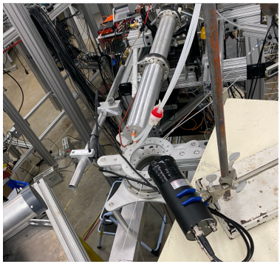
Gamma Ray and Neutron Sources
⁷Li(p, n)⁷Be and ¹³C(α, n)¹⁶O emit neutrons in all directions, but with characteristic energies at each angle
PMT can swivel around reaction point to capture specific neutron energies
Gamma rays come from background interactions and ¹³C(α, n)¹⁶O
Background interactions include beta decay of potassium-40, releases gamma ray at 1.5 MeV
¹³C(α, n)¹⁶O emits gamma rays at 6 MeV
Notes:
The objective of this measurement is an R&D effort in the LEGEND experiment to characterize PEN
7Li(p, n)7Be = Lithium target, proton hits target, neutron flies out, Beryllium left over
Incident particle hits target, creates neutrons flying in every direction, but neutrons have specific energies at specific angles, move scintillator around to specific angles to capture specific neutron energies
Gamma rays come from background interactions and 13C(alpha, n)16O also emits gamma rays at 6 MeV
Background interactions example: potassium-40 is naturally occurring everywhere, beta decays and releases a gamma ray when it does at 1.46 MeV
https://chem.libretexts.org/Bookshelves/Physical_and_Theoretical_Chemistry_Textbook_Maps/Supplemental_Modules_(Physical_and_Theoretical_Chemistry)/Spectroscopy/Electronic_Spectroscopy/Jablonski_diagram
Silver tube is vacuum tube carrying H++ and He++ beam, Li or C foil on tantalum backing at end of tube, water cooled, PMT on a table can swivel around

Slide 8
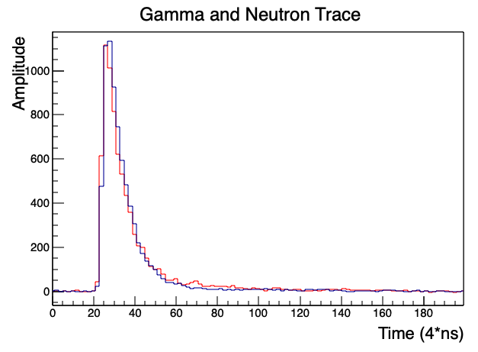
Sample of Data Used
Bin width is 4 ns
Energy deposition is in range of E = 1 – 4.5 MeV
Low energy measurements cut out
Gamma Trace
Neutron Trace
Notes:
Shape of scintillation pulse called waveform or trace
Each bin is one sample taken in 4 ns (width of each bin is 4 ns)
Higher energy deposition creates larger signal, higher amplitude
Energy deposited by gamma rays and neutrons into scintillator (a little more complicated, but this is good enough)
E = 1 – 4.5 MeV

Slide 9
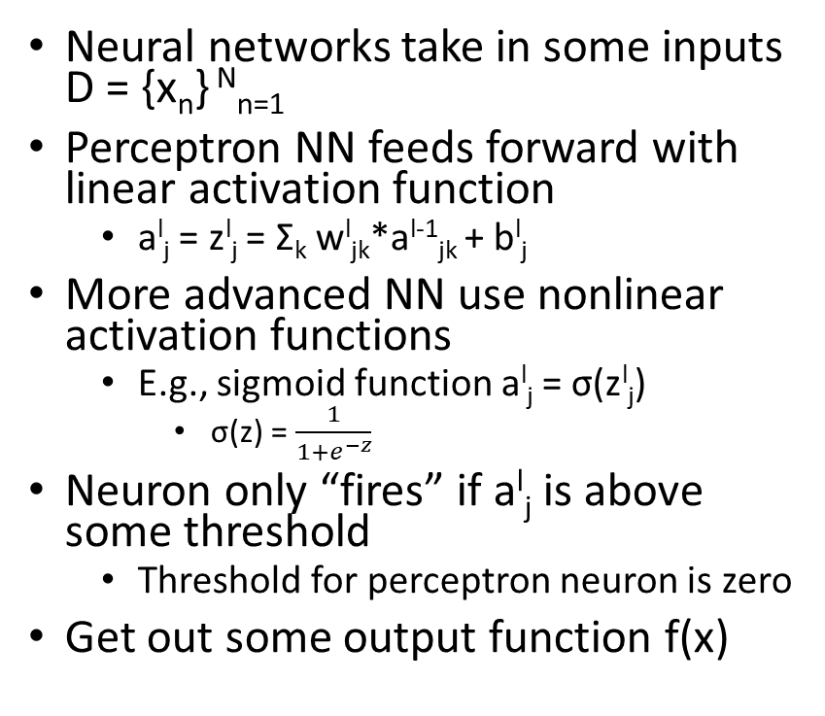
Machine Learning Basics
Inputs
Neural networks take in some inputs D = {x_{n}} ^{N}_{n=1}
Perceptron NN feeds forward with linear activation function
a^{l}_{j} = z^{l}_{j} = Σ_{k} w^{l}_{jk}*a^{l-1}_{jk} + b^{l}_{j}
More advanced NN use nonlinear activation functions
E.g., sigmoid function a^{l}_{j} = σ(z^{l}_{j})
σ(z) = $\frac{1}{1+e^{−z}}$
Neuron only “fires” if a^{l}_{j} is above some threshold
Threshold for perceptron neuron is zero
Get out some output function f(x)
x₁
a⁰₁
w¹₁
b¹₁
a¹₁
x₂
a⁰₂
Output function f(x)
a³₁
x₃
a⁰₃
w¹₂
b¹₂
a¹₂
x₄
a⁰₄
Input Layer
Hidden Layer
Output Layer
Notes:
Perceptron neurons fire if z is above some threshold; if neuron doesn’t fire, it just doesn’t propagate forward
Another activation function (that I don’t have time to discuss) is the “relu” function

Slide 10
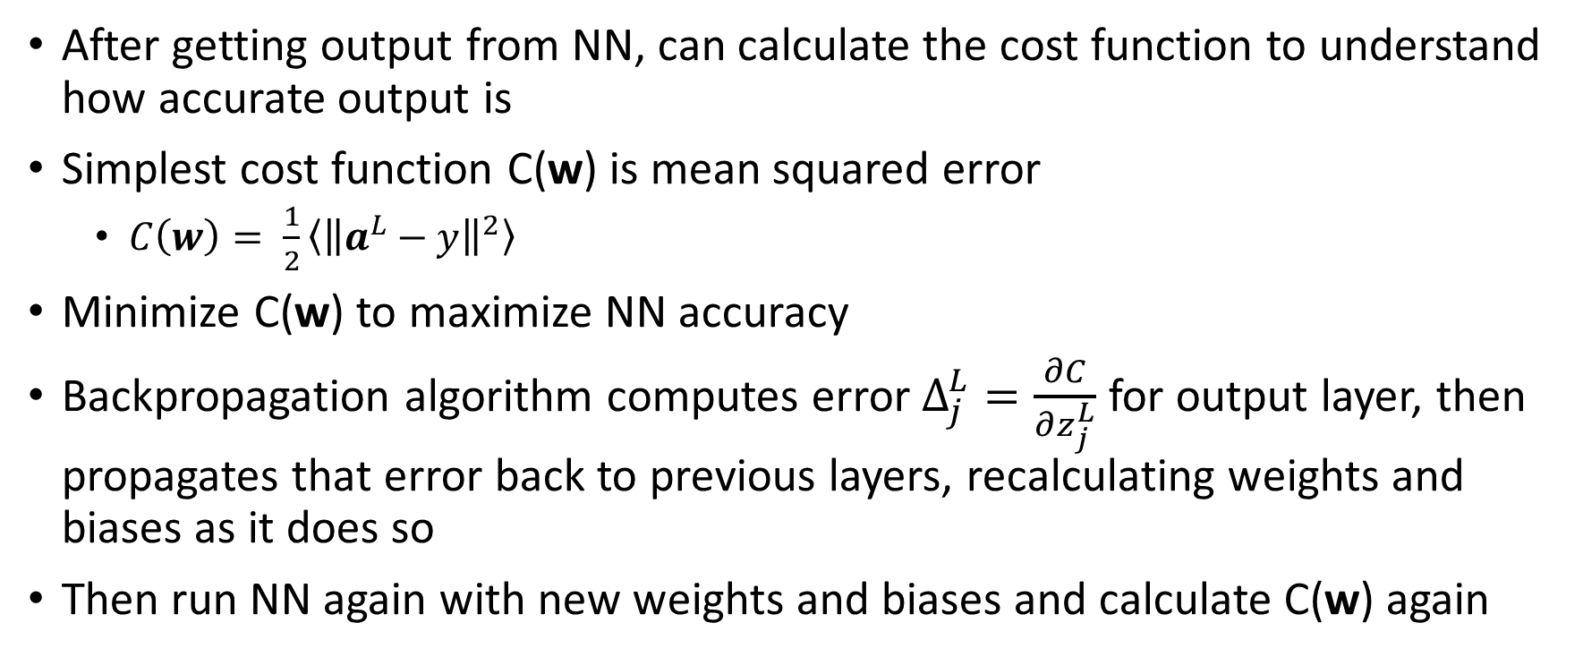
Backpropagation
After getting output from NN, can calculate the cost function to understand how accurate output is
Simplest cost function C(w) is mean squared error
$C\left(w\right)= \frac{1}{2}\left\langle {\left\|a^{L}−y\right\|}^{2}\right\rangle$
Minimize C(w) to maximize NN accuracy
Backpropagation algorithm computes error $Δ_{j}^{L}=\frac{∂C}{∂z_{j}^{L}}$ for output layer, then propagates that error back to previous layers, recalculating weights and biases as it does so
Then run NN again with new weights and biases and calculate C(w) again
Notes:
y is target – “correct answer”
$Δ_{j}^{L}=\frac{∂C}{∂z_{j}^{L}}=(a_{j}^{L}−y_{j})f^{′}(z_{j}^{L}$)

Slide 11

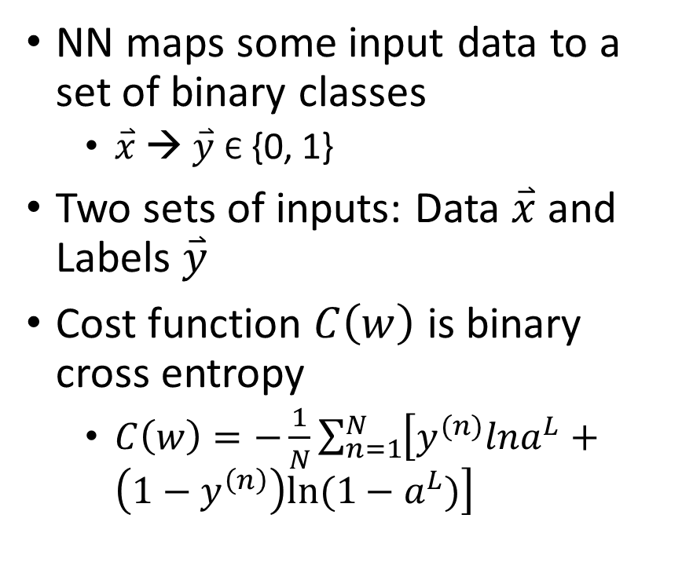
Binary Classification
NN maps some input data to a set of binary classes
$\overset{⃑}{x}$ → $\overset{⃑}{y}$ Є {0, 1}
Two sets of inputs: Data $\overset{⃑}{x}$ and Labels $\overset{⃑}{y}$
Cost function $C\left(w\right)$ is binary cross entropy
$C\left(w\right)=−\frac{1}{N}\sum_{n=1}^{N}{\left[y^{(n)}lna^{L}+\left(1−y^{\left(n\right)}\right)ln⁡(1−a^{L})\right]}$

Slide 12
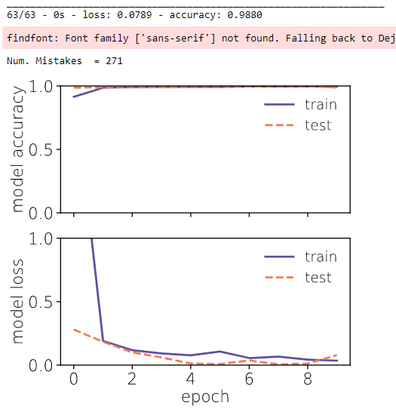
Specific Classification Project
Inputs:
Randomly ordered list of 10,000 gamma pulses and 10,000 neutron pulses
Second list of 1’s and 0’s labeling events in first list
Architecture:
Input layer: Dense, 10 neurons, input shape = 200, ReLU activation function
Hidden layer: Dense, 5 neurons, ReLU activation function
Output layer: Dense, 1 neuron, sigmoid activation function
Cycles through NN 10 times
Batch Size = 1,000

Slide 13
References
Thank you to Yuri Efremenko, Brennan Hackett and Jesse Harris
B. Hackett, R. Toomey, “Measurement of Luminescent Properties of Polyethylene 2,6-Naphthalate,” (2021).
Hackett, Brennan. Scintillation and Optical Properties of the Low-Background Scintillator, PEN. 2021. PowerPoint Presentation.
J. Harris, “An A.I. Approach to Higgs Decay,” (2020).

